Slide 1
CLBist Data Converter User Manual

Slide 2
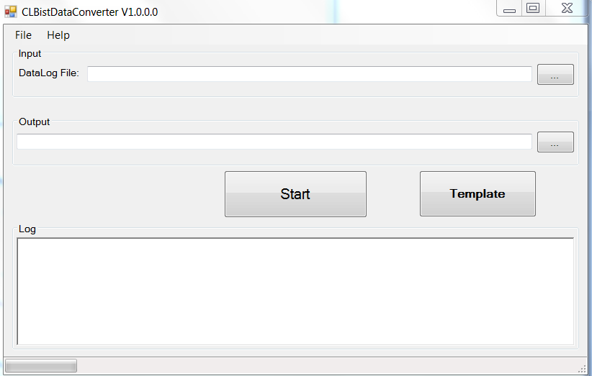
CLBist Data Converter
Purpose : Base on first release test program datalog to get needed data and list it in csv file with specified column name.
GUI
Input file
Output path
Base Datalog: First release datalog.
Output: Reoprt output path.

Slide 3
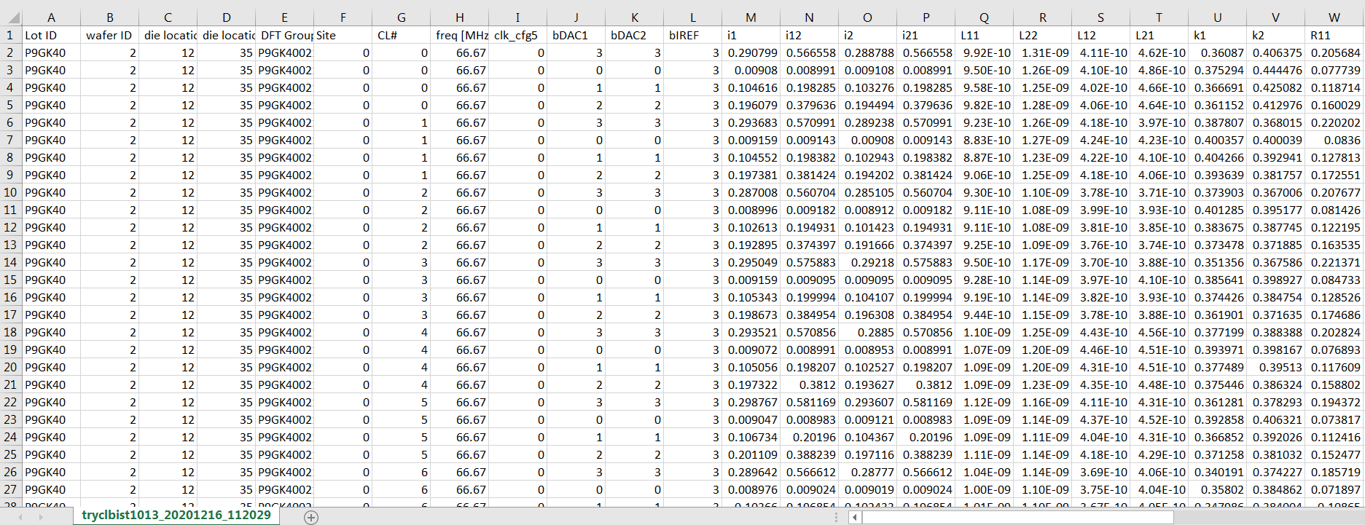
CLBist Data Converter
Converted data from datalog

Slide 4
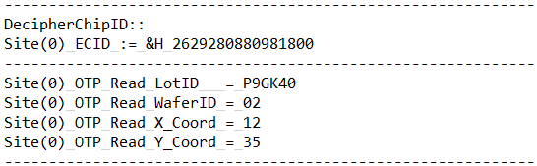
CLBist Data Converter
1. ColumnA: Lot ID
2. ColumnB: wafer ID
3. ColumnC: die location X
4. ColumnD: die location Y

Slide 5
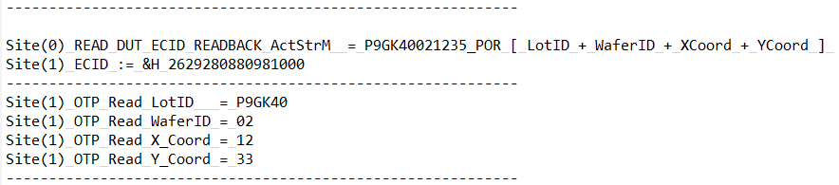
CLBist Data Converter
5. ColumnE: DFT Group
6. ColumnF: Site

Slide 6
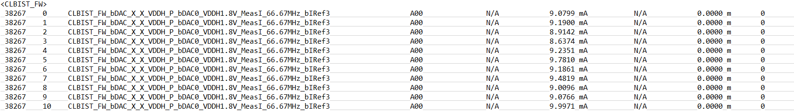
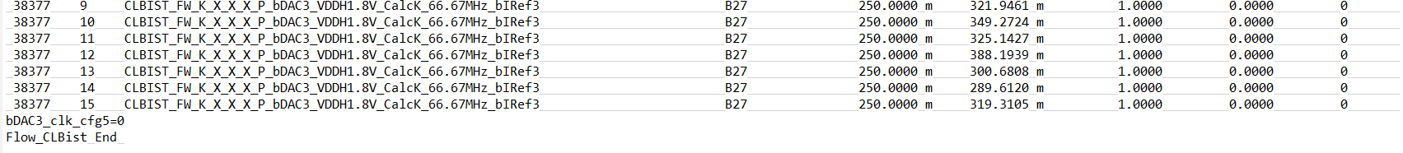
CLBist Data Converter
7. ColumnG: CL#
8. ColumnH: freq [MHz]
10/11. ColumnJ/K: bDAC1/2
9. ColumnI: clk_cfg5
12. ColumnL: bIREF

Slide 7
CLBist Data Converter
When test name with bDAC/bDAC-dual
13. ColumnM: i1
15. ColumnO: i2
14. ColumnN: i12
16. ColumnP: i21

Slide 8
CLBist Data Converter
When test name with L/M
17. ColumnQ: L11
18. ColumnR: L22
19. ColumnS: L12
20. ColumnT: L21

Slide 9
CLBist Data Converter
When test name with K
21. ColumnU: K1
22. ColumnV: K2

Slide 10
CLBist Data Converter
When test name with Rac11/Rac22/Rac12/Rac21
23. ColumnW: R11
24. ColumnX: R22
25. ColumnY: R12
26. ColumnZ: R21

Slide 11
CLBist Data Converter
When test name with Rdc
27. ColumnAA: Rdc1
28. ColumnAB: Rdc2

Slide 12
CLBist Data Converter
When test name with Rref
29. ColumnAC: RrefA
30. ColumnAD: RrefB

Slide 13
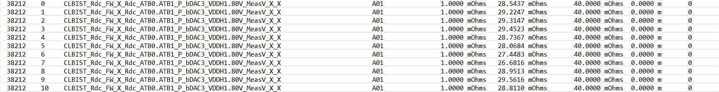
CLBist Data Converter
For Column AE = Column Q – Column R
For Column AF = Column S – Column T
For Column AG = Column W – Column X
For Column AH = Column Y – Column Z
For Column AI = (Column Q + Column R) /2
For Column AJ = (Column S + Column T) /2
For Column AK : Group9 in test name VDDH’s value

